Slide 1

IoT-Based Smart Blinds Monitoring System
Optimizing Indoor Environments for Comfort and Sustainability
sam almahdi 231023247
Abdulrahman Al-Maamarı 231023250
Mogdam Khalid 231023210

Slide 2
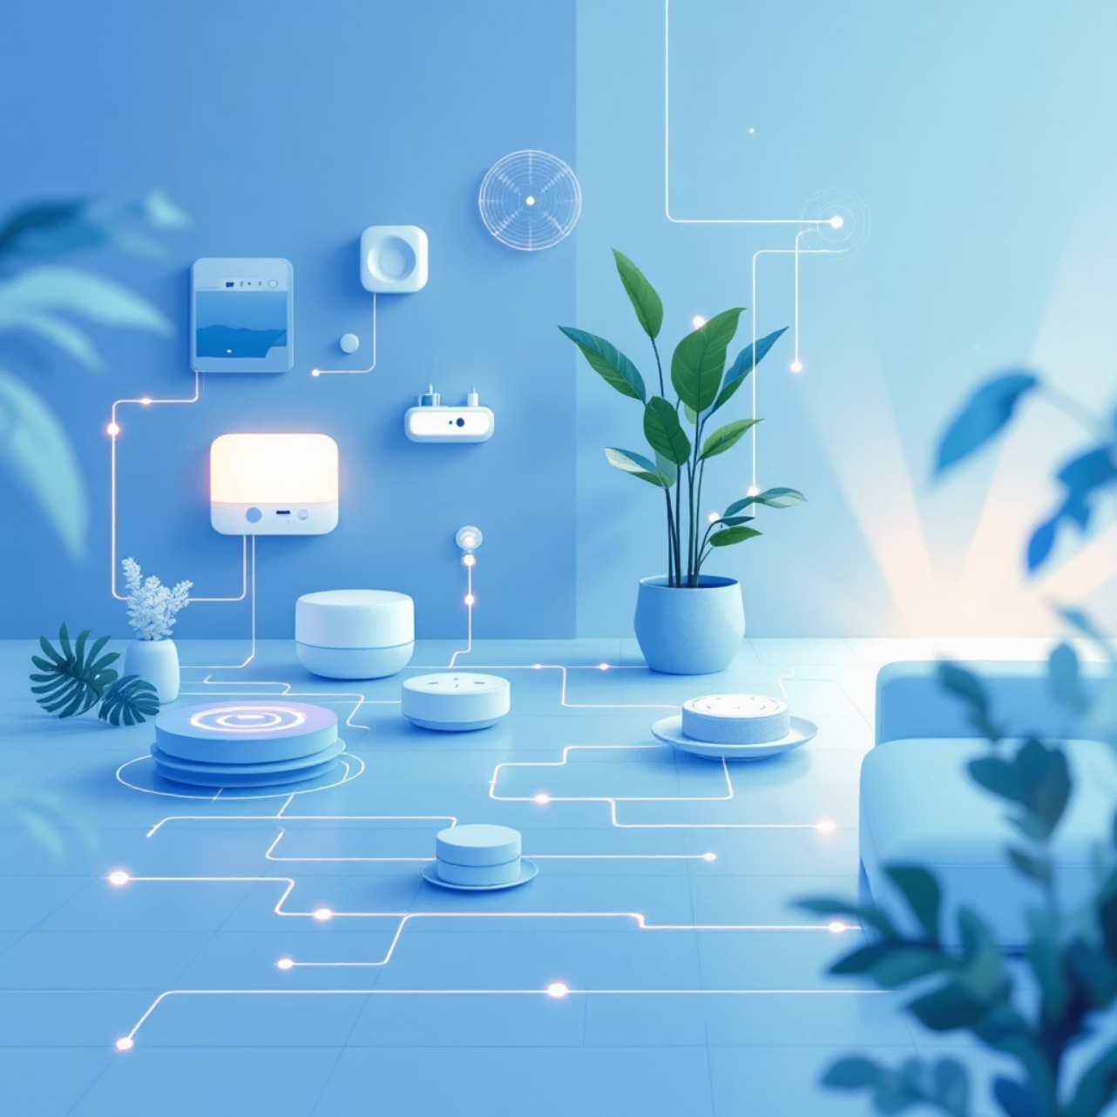
Introduction: The Dawn of Smart Living
Modern living demands intelligent solutions for energy management and comfort. Our IoT-based Smart Blinds Monitoring System addresses this need by integrating real-time environmental data with automated control.
This system provides a proactive approach to managing indoor light and temperature, ultimately enhancing living and working spaces while reducing energy consumption.

Slide 3
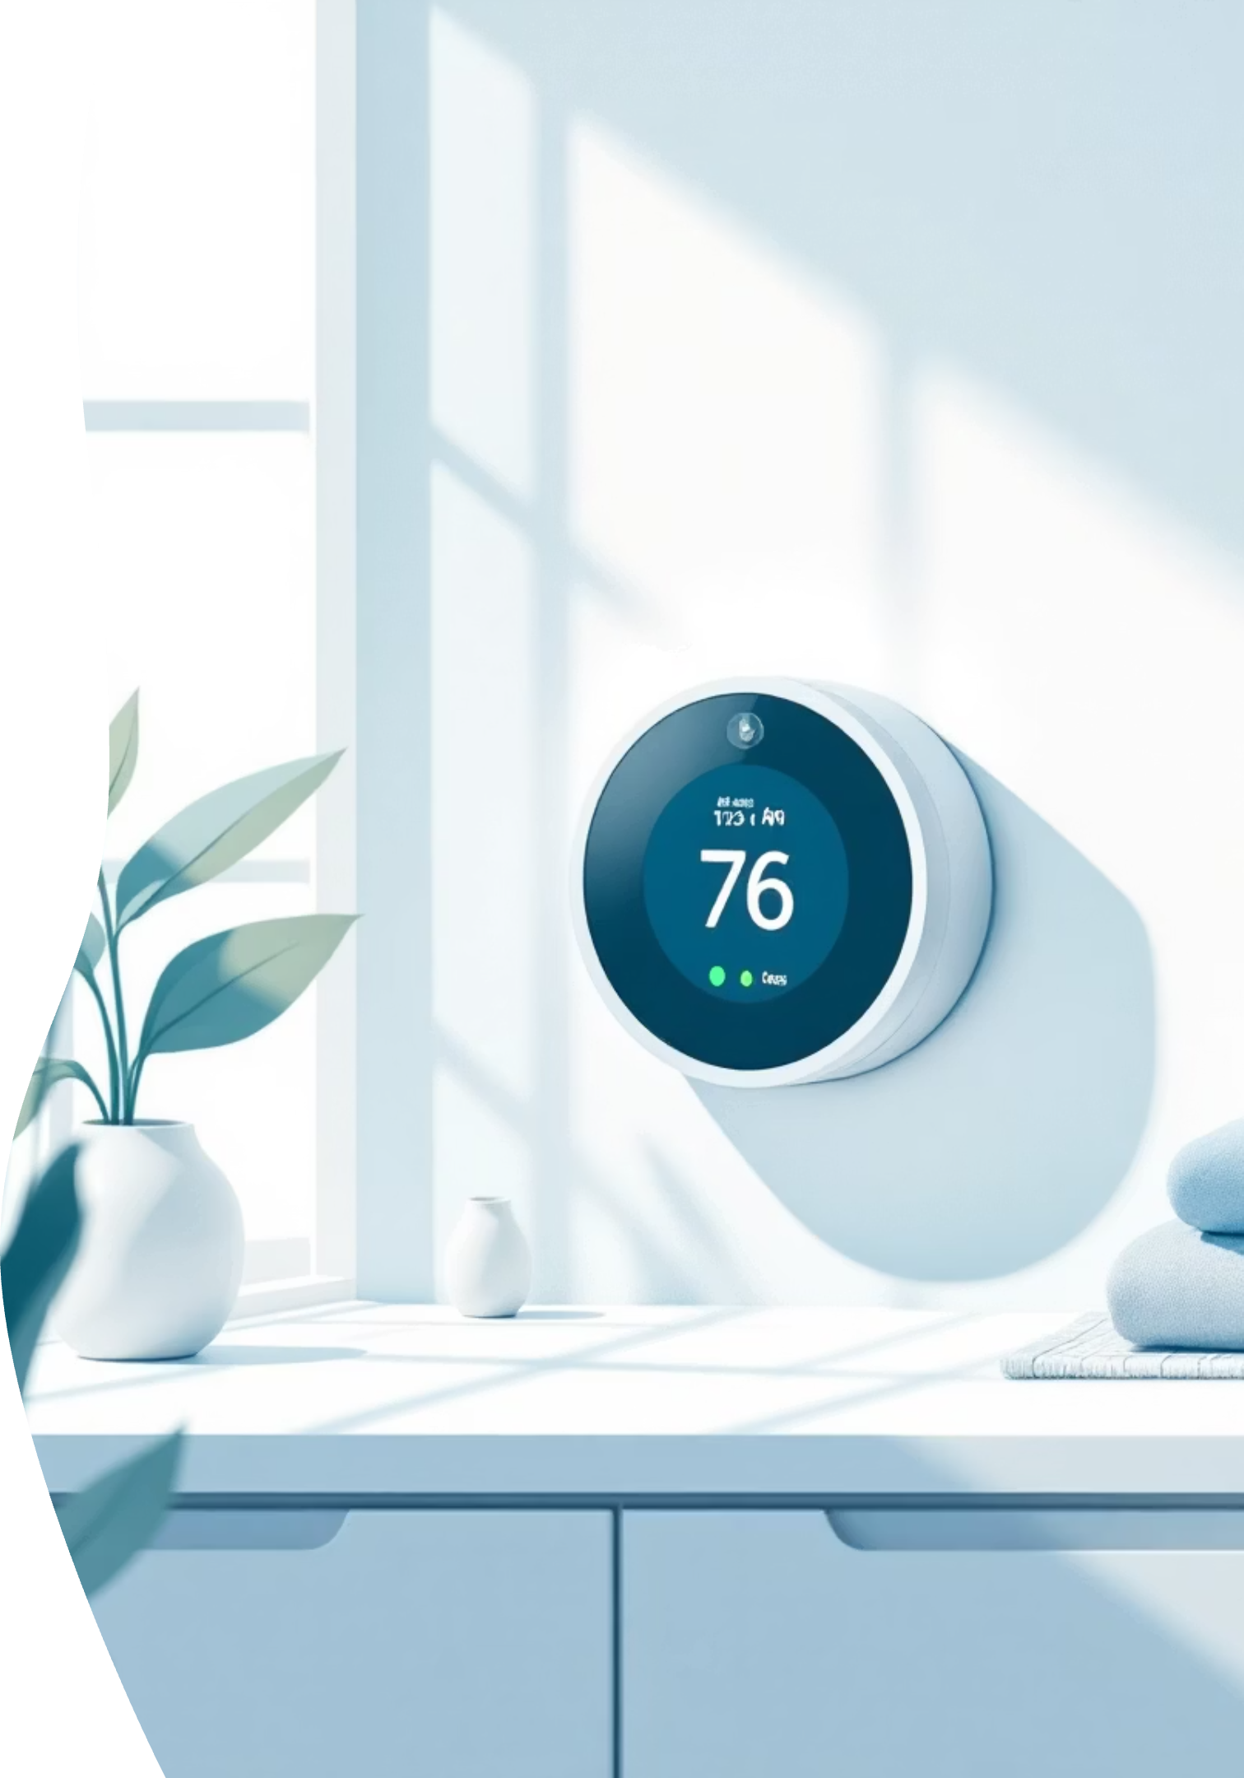
Motivation: Driving Sustainable & Comfortable Spaces
Energy Efficiency
Enhanced Comfort
Reduce heating and cooling costs by intelligently managing solar gain and heat loss through windows.
Maintain optimal indoor temperatures and lighting levels, preventing glare and uncomfortable heat build-up.
Smart Automation
Leverage IoT to create a responsive environment, adapting dynamically to changing conditions without manual intervention.

Slide 4




Problem Statement: Uncontrolled Environments
Traditional blinds offer manual control, leading to inconsistent indoor conditions and wasted energy. Fluctuations in light intensity and temperature directly impact comfort and energy usage, often without effective real-time management.
Energy Waste
Inefficient management of solar radiation leads to increased HVAC demands.
Discomfort
Rooms can become too hot, too cold, or experience excessive glare, affecting occupant well-being.
Manual Effort
Constant adjustment of blinds is impractical and often neglected, negating potential benefits.

Slide 5

Project Objectives: Crafting Intelligent Control
Our primary goal is to design and implement a system that autonomously optimizes indoor environments.
1
2
Develop IoT Sensor Network
Establish Data Pipeline
Deploy sensors to accurately measure light intensity and temperature in real-time.
Collect, store, and process sensor data efficiently for analysis and decision-making.
3
4
Implement Control Logic
Visualize & Monitor
Design an algorithm to automatically adjust blinds based on predefined thresholds and environmental data.
Create an intuitive dashboard for real-time monitoring and historical data analysis.

Slide 6
Dataset Overview: Real-World Environmental Data
Our project utilizes a dataset comprising time-series readings from IoT sensors, capturing crucial environmental parameters.
Feature
Description
Unit/Type
Example
Timestamp
Date and time of reading
Datetime
2023-10-27 14:30:00
Light Intensity
Ambient light level
Lux
750
Temperature
Room temperature
Celsius
23.5
Blind State
Current position of the blinds
Percentage (0-100)
50% open
This rich dataset is fundamental for understanding patterns and training our control algorithms.

Slide 7
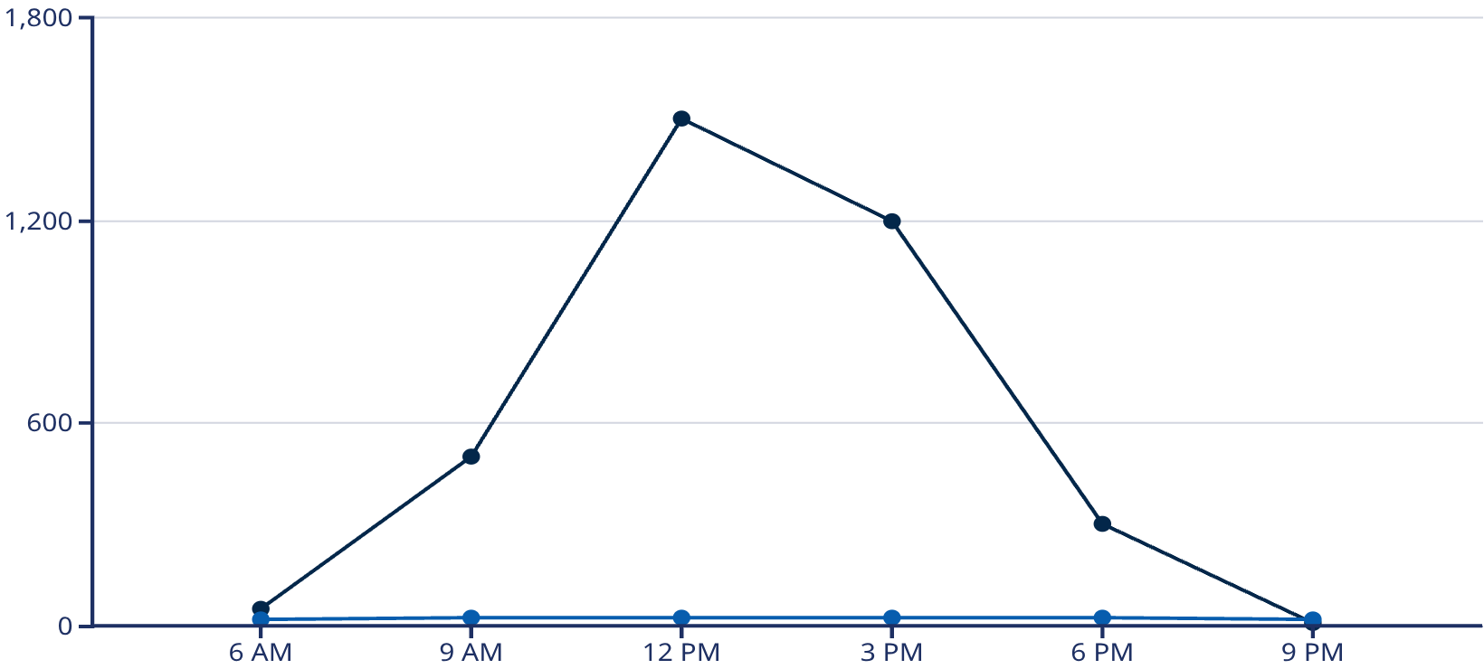
Data Analysis (EDA): Unveiling Environmental Patterns
Exploratory Data Analysis (EDA) revealed key relationships between light intensity and temperature fluctuations throughout the day.
We observed strong correlations, indicating that higher light intensity often leads to increased indoor temperatures, particularly during peak daylight hours. These insights inform our control logic.
Light Intensity (Lux)
Temperature (C)
Average daily light intensity and temperature trends.

Slide 8
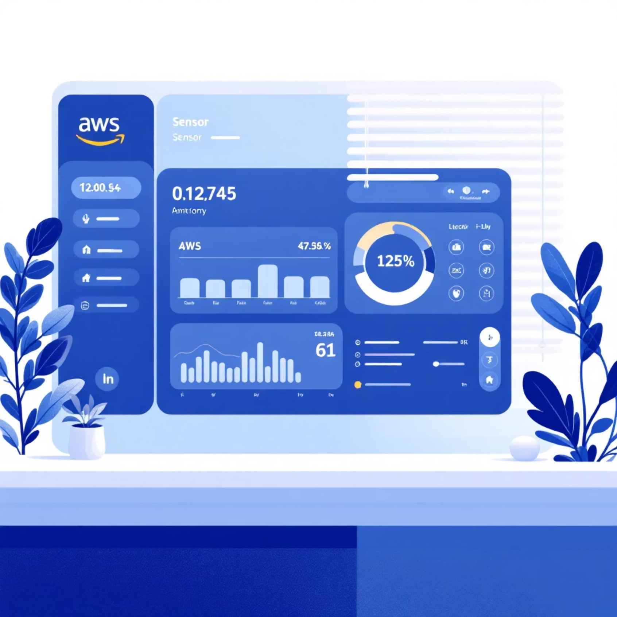
Dashboard & AWS Deployment: Real-time Control at Your Fingertips
Our intuitive dashboard provides a clear overview of the environment, allowing users to monitor live sensor data, blind states, and energy savings.
Deployed on AWS, the system leverages cloud scalability and reliability for seamless data ingestion, processing, and real-time control commands.
Live sensor feeds (temperature, light)
Historical data trends
Manual override option
Energy savings metrics

Slide 9
Results & Insights: A Smarter Environment
The Smart Blinds Monitoring System successfully demonstrated its ability to maintain optimal indoor conditions.
20%
15%
90%
Energy Savings
Comfort Improvement
System Accuracy
Reduction in HVAC energy consumption due to optimized solar heat gain.
Reduction in instances of uncomfortable temperatures and glare throughout the day.
High accuracy in maintaining target light and temperature ranges.
These results underscore the system's effectiveness in delivering both environmental comfort and tangible energy benefits.

Slide 10

Conclusion & Future Work: The Road Ahead
The IoT-based Smart Blinds Monitoring System provides a robust framework for intelligent environmental control. We've proven its potential for significant energy savings and enhanced occupant comfort.
Conclusion
Future Work
Successfully integrated IoT sensors, cloud processing, and automated blinds.
Integrate machine learning for predictive control and personalized preferences.
Achieved measurable improvements in energy efficiency and indoor comfort.
Expand sensor network to include humidity and air quality.
Develop mobile application for remote control and notifications.
Developed a user-friendly monitoring and control dashboard.
Explore integration with existing smart home ecosystems.

